Slide 1

ONLINE STORE MANAGENENT SYSTEM under guidance of Raghava gowda
CPS 510 18_FA_sA_T6
TEAM LEADER - VAMSI CHARAN ADARI
Zeel sureshbhai prajapati
Romana KHATOON

Slide 2
Project Description
Online Store Management System is a website which acts as a market platform for both buyers and sellers. The main objective of the application is to make direct selling from sellers to buyers without any storage or warehouse to store the products.

Slide 3
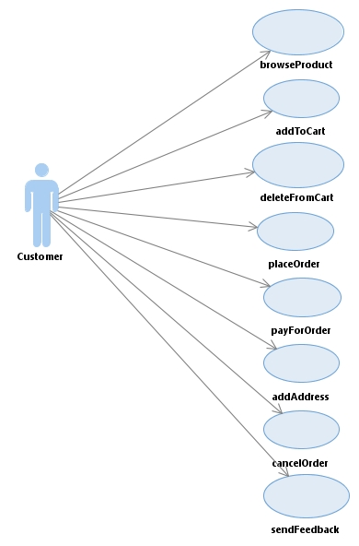
Use Case Diagram

Slide 4
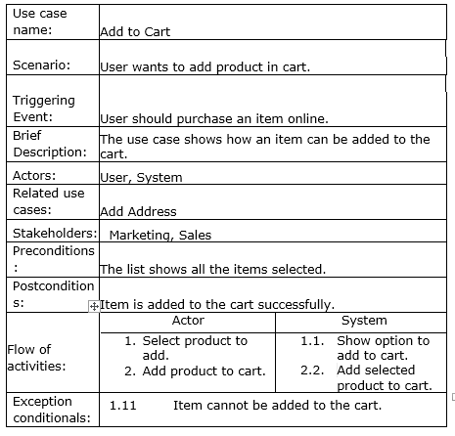
Use Case Description

Slide 5
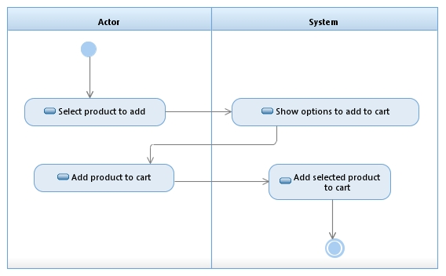
Activity
diagram

Slide 6
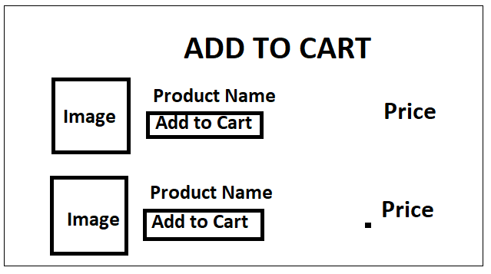
Screen Design

Slide 7
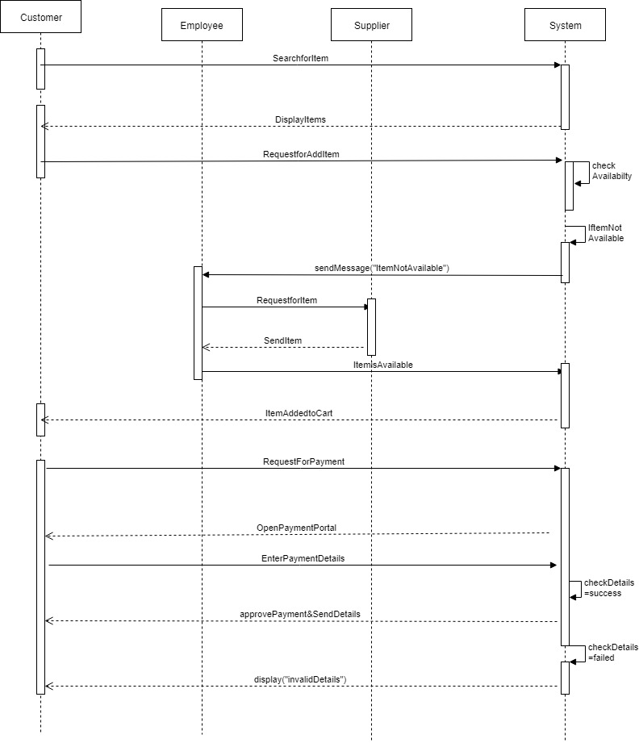
Sequence
diagram

Slide 8
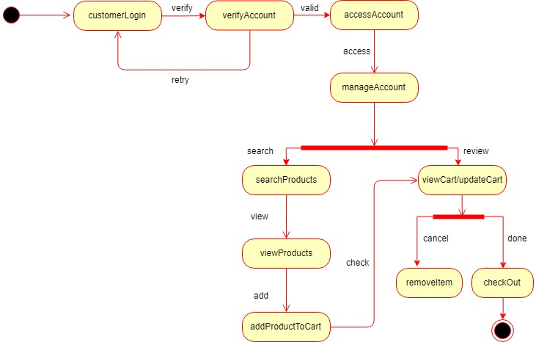
StateChart
diagram

Slide 9
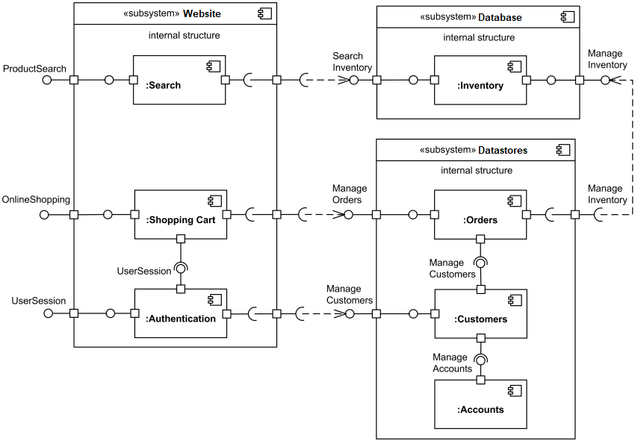
Component
diagram

Slide 10
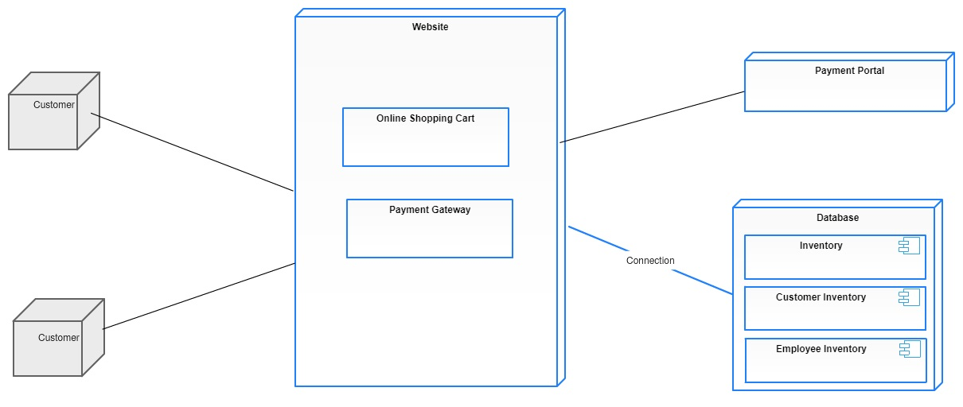
Deployment
diagram

Slide 11
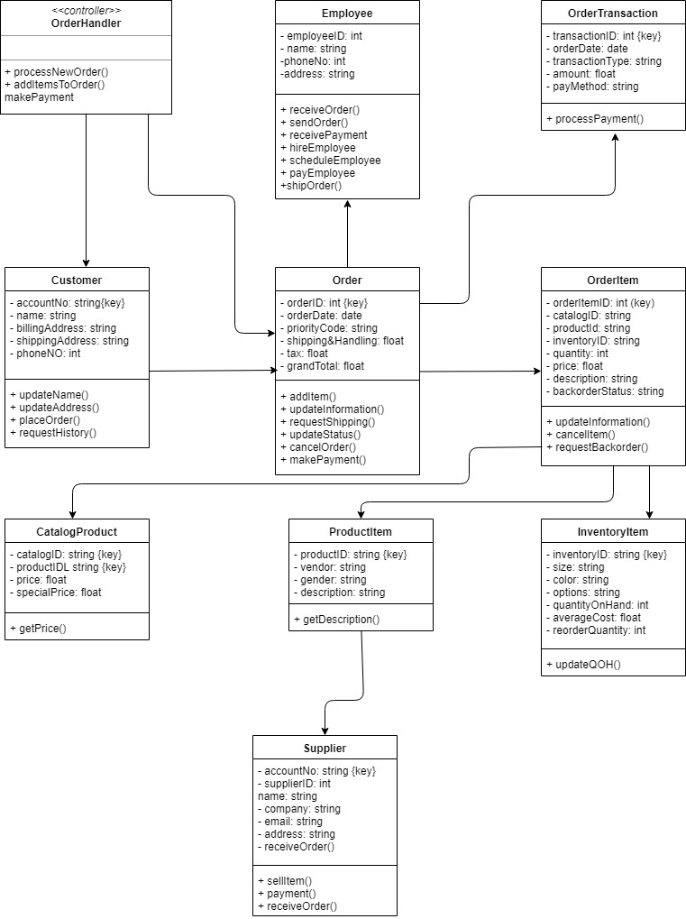
Class
diagram

Slide 12
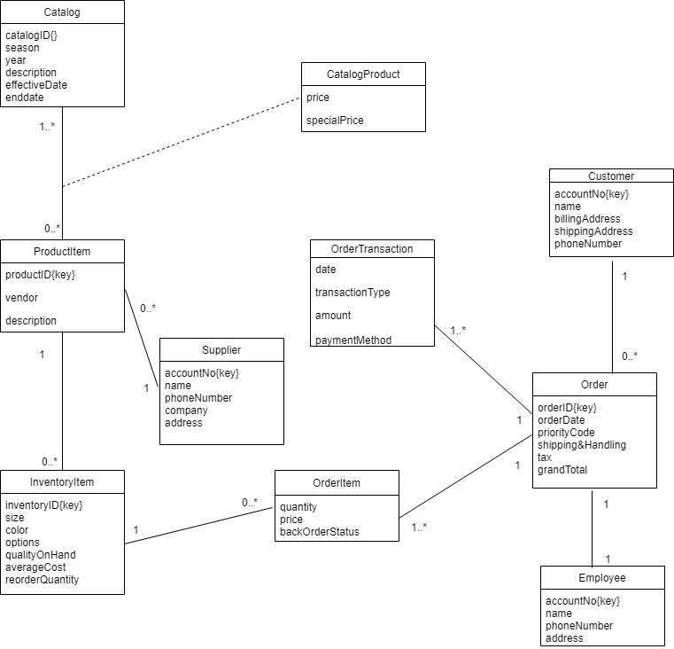
Domain Class
diagram

Slide 13
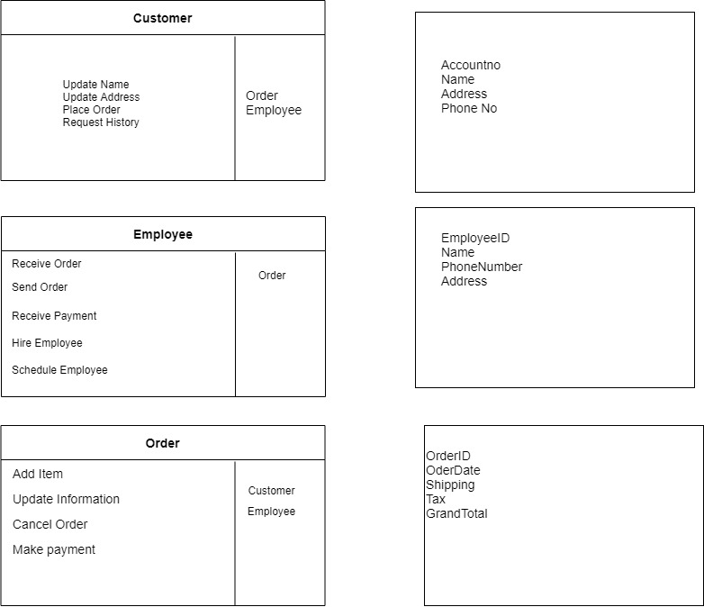
CRC Card

Slide 14
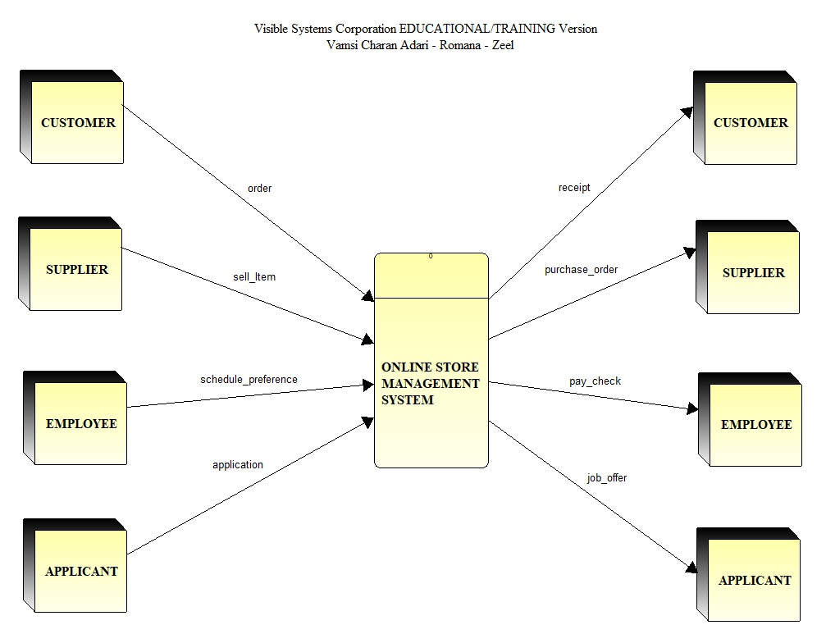
Context Level DFD

Slide 15
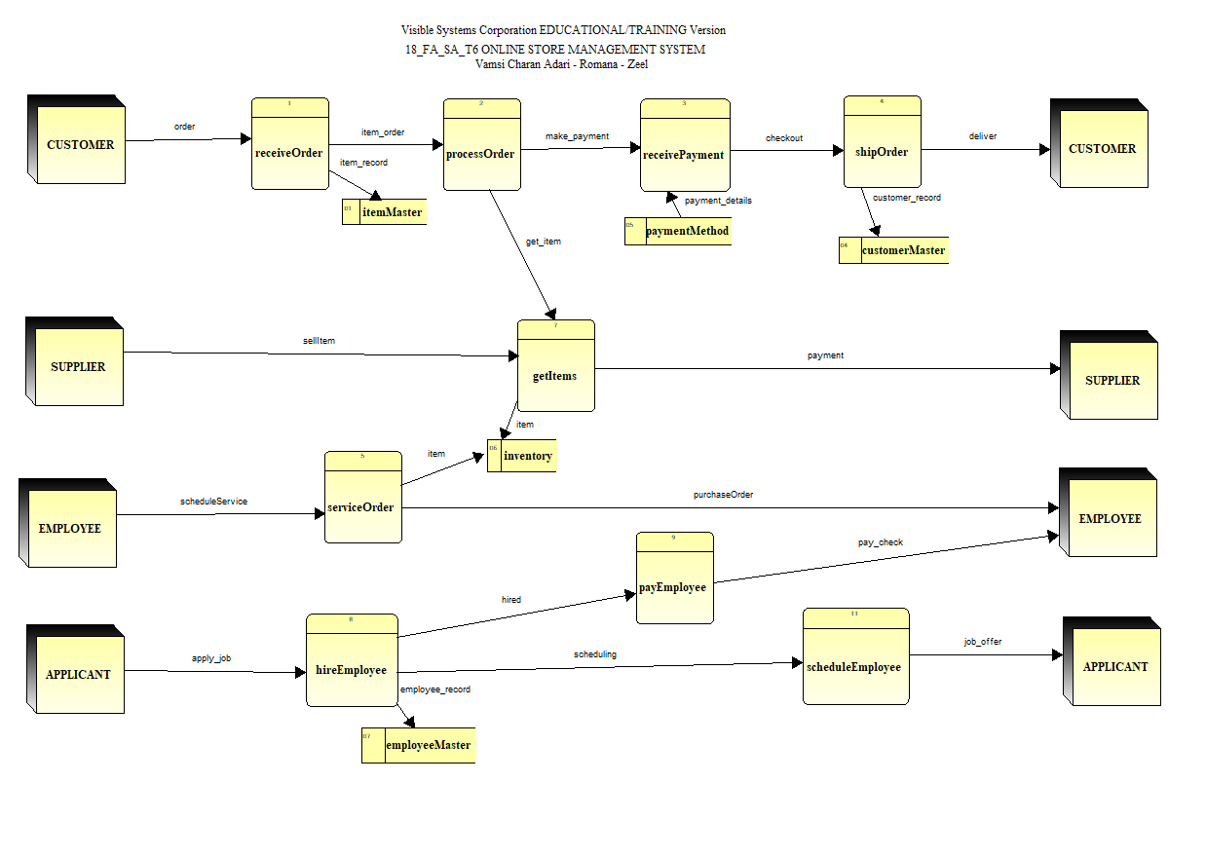
Level 0 DFD

Slide 16
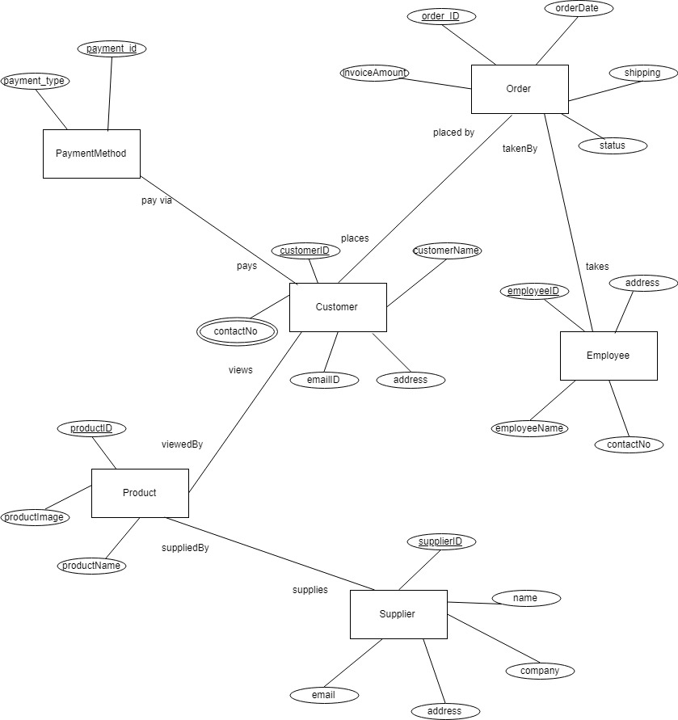
E-R Diagram

Slide 17
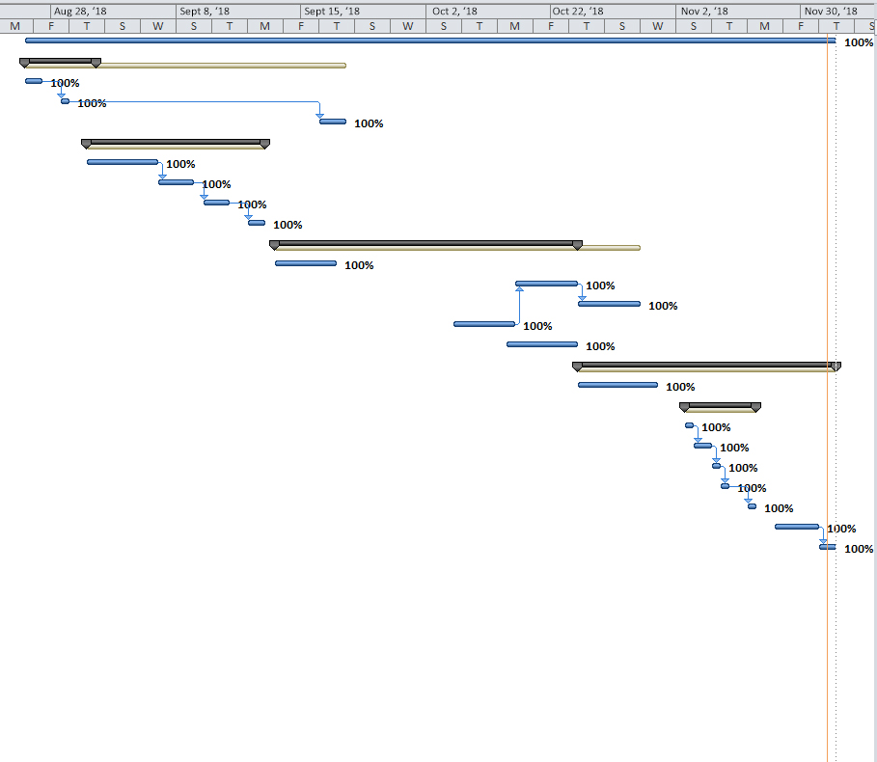
Gantt Chart 1

Slide 18
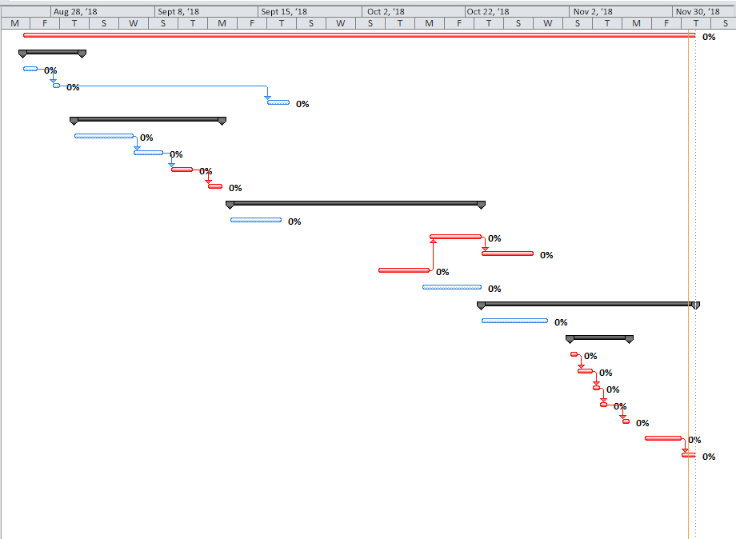
Gantt Chart 2

Slide 19
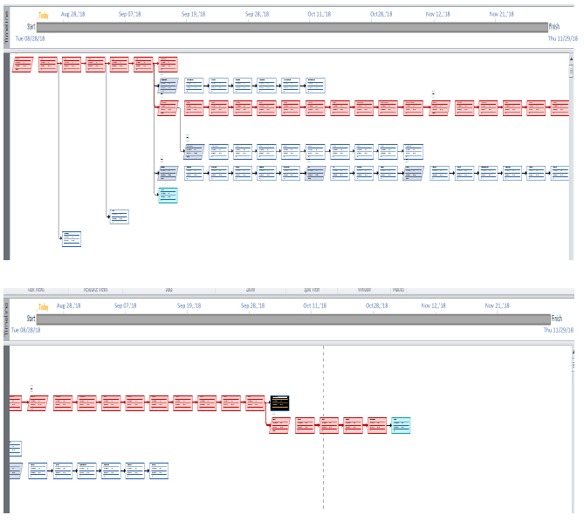
PERT Network

Slide 20
Thank you

